Slide 1
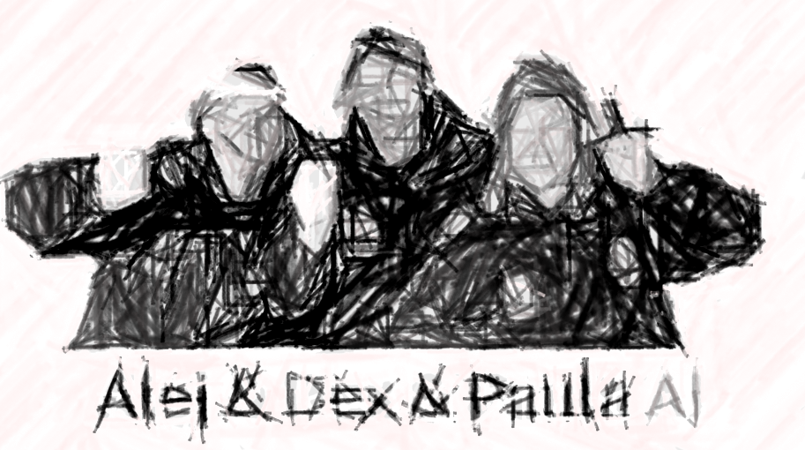
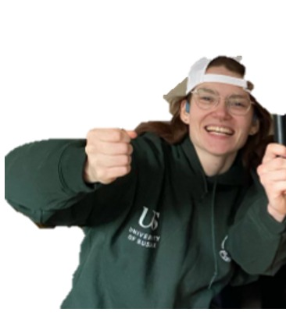




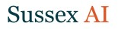
Using Machine Learning in Science
Dexter R. Shepherd
d.r.shepherd@sussex.ac.uk
University of Sussex

Slide 2
Recap
Employed methods like PCA and dimensionality reduction
Learned about classifiers and regression models
Worked with datasets and open dataset

Slide 3
Contents
Building datasets
Fail cases of machine learning
How we can be robust

Slide 4
Commitment to open science
So much data is behind a paywall, which moves AI into a scary place! What if only the best AIs belong to large companies who do not have to publish their methods or ethics…
By making datasets and models open source, others can learn from, benefit from and improve upon your original creation.

Slide 5
What does accuracy tell us?
How much of this data we got correct
But does our dataset represent everything?

Slide 6
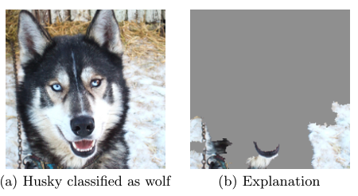
Example
A model trained to distinguish between dogs and wolfs
Jiawei, "One pixel attack for fooling deep neural networks." IEEE TEC 2019
Ribeiro, Singh, and Guestrin. "" Why should i trust you?" Explaining the predictions of any classifier." ACM SIGKDD 2016.

